Slide 1

Multivariable Optimization
MTH 564 – Mathematical Modeling

Slide 2
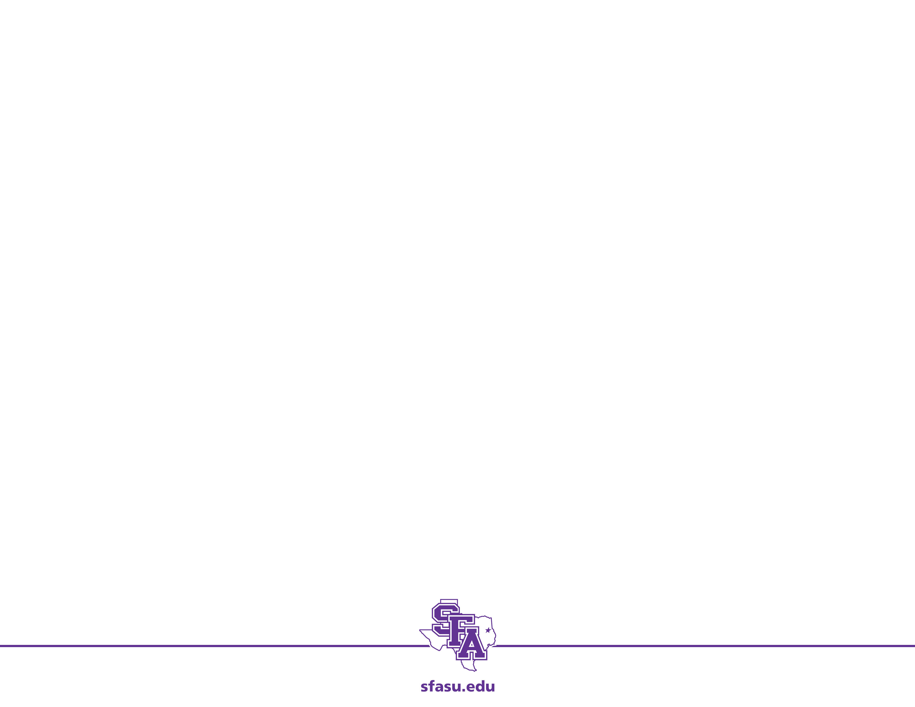
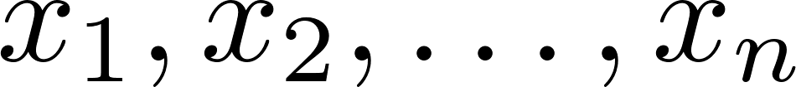
Multivariable Optimization
Many optimization problems require the consideration of several independent variables
The independent variables are usually denoted
Simples type involves finding the maximum or minimum of a differentiable function of several variables over a nice set.

Slide 3
Example: TV Manufacturing
A manufacturer of color TV sets is planning the introduction of two new products, a 19-inch LCD flat panel set with a MRSP of $339 and a 21-inch LCD flat panel set with an MRSP of $399. The cost to the company is $195 per 19-inch set and $225 per 21-inch set, plus an additional fixed costs of $400,000. In the competitive market in which these sets are sold, the number of sales per year will affect the average selling price. It is estimated that for each type of set, the average selling price drops by one cent for each additional unit sold. Furthermore, sales of the 19-inch set will affect sales of the 21-inch set, and vice-versa. It is estimated that the average selling price for the 19-inch set will be reduced by an additional $0.003 for each 21-inch set sold, and the price for the 21-inch set will decrease by $0.004 for each 19-inch set sold. How many units of each type should be manufactured?

Slide 4
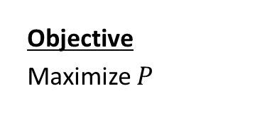

Step 1: Ask the question.
Variables:
s – # of 19-inch sets sold (per year)
t – # of 21-inch sets sold (per year)
p – selling price for 19 inch set ($)
q – selling price for 21 inch set ($)
C – cost of manufacturing TVs ($/yr)
R – revenue from the sale of TVs ($/yr)
P – profit from the sale of TVs ($/yr)
Let’s check units.
Assumptions:
$$s≥0$$
$$t≥0$$
$$p=339−0.01s−0.003t$$
$$q=399−0.004s−0.01t$$
$$C=400000+195s+225t \\ R=ps+qt \\ P=R−C$$
Objective
Maximize $P$
Parameters:
$0.01 – amount of price drop per unit sold
$0.003 – amount of price drop for 19-inch set for each 21-inch sold
$0.004 – amount of price drop for 21-inch set for each 19-inch sold

Slide 5
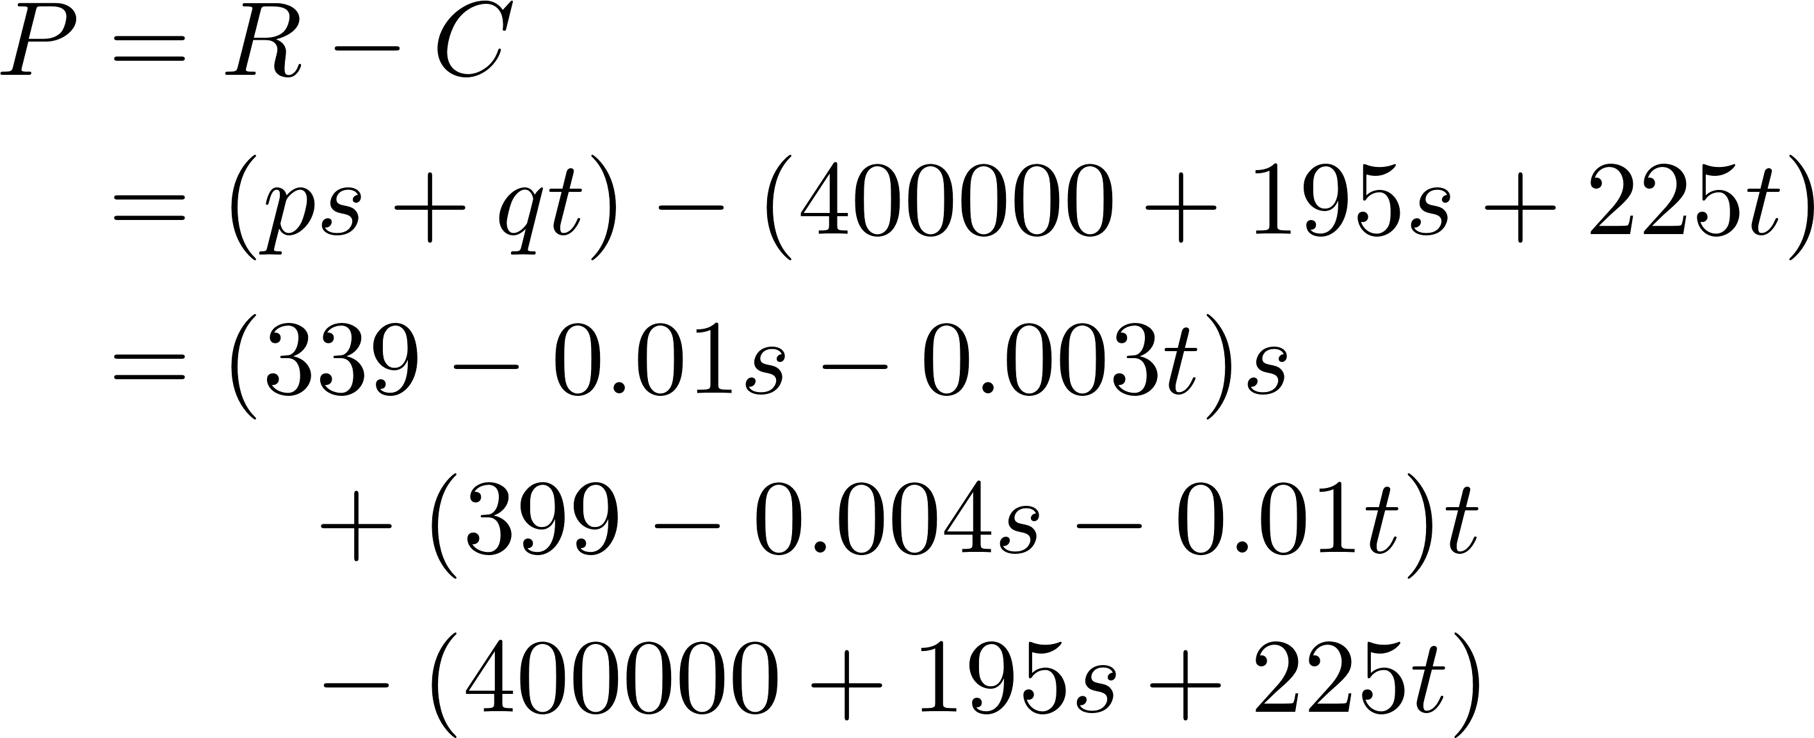
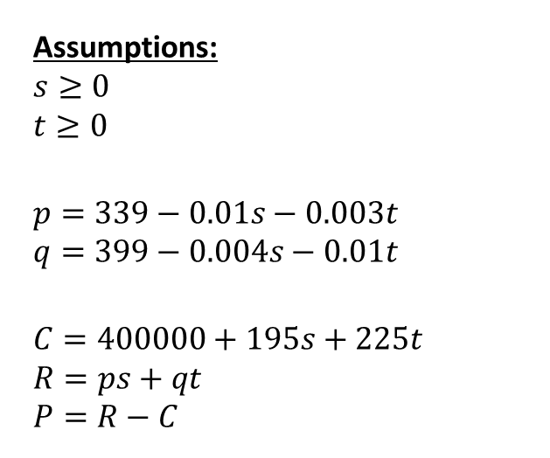
Step 2: Select the modeling approach
Assumptions:
$$s≥0$$
$$t≥0$$
$$p=339−0.01s−0.003t$$
$$q=399−0.004s−0.01t$$
$$C=400000+195s+225t \\ R=ps+qt \\ P=R−C$$
Working backwards through our assumptions:
The profit function can be expressed in terms of just the independent variables s and t. Therefore, this is a multivariable optimization problem.

Slide 6
Multivariable Optimization Models
Goal is to determine the value of control variables which maximize or minimize a function of interest
Variables typically have constraints of some type on them
These types of problems are often introduced in an introductory multivariable calculus course (often Calculus III)

Slide 7
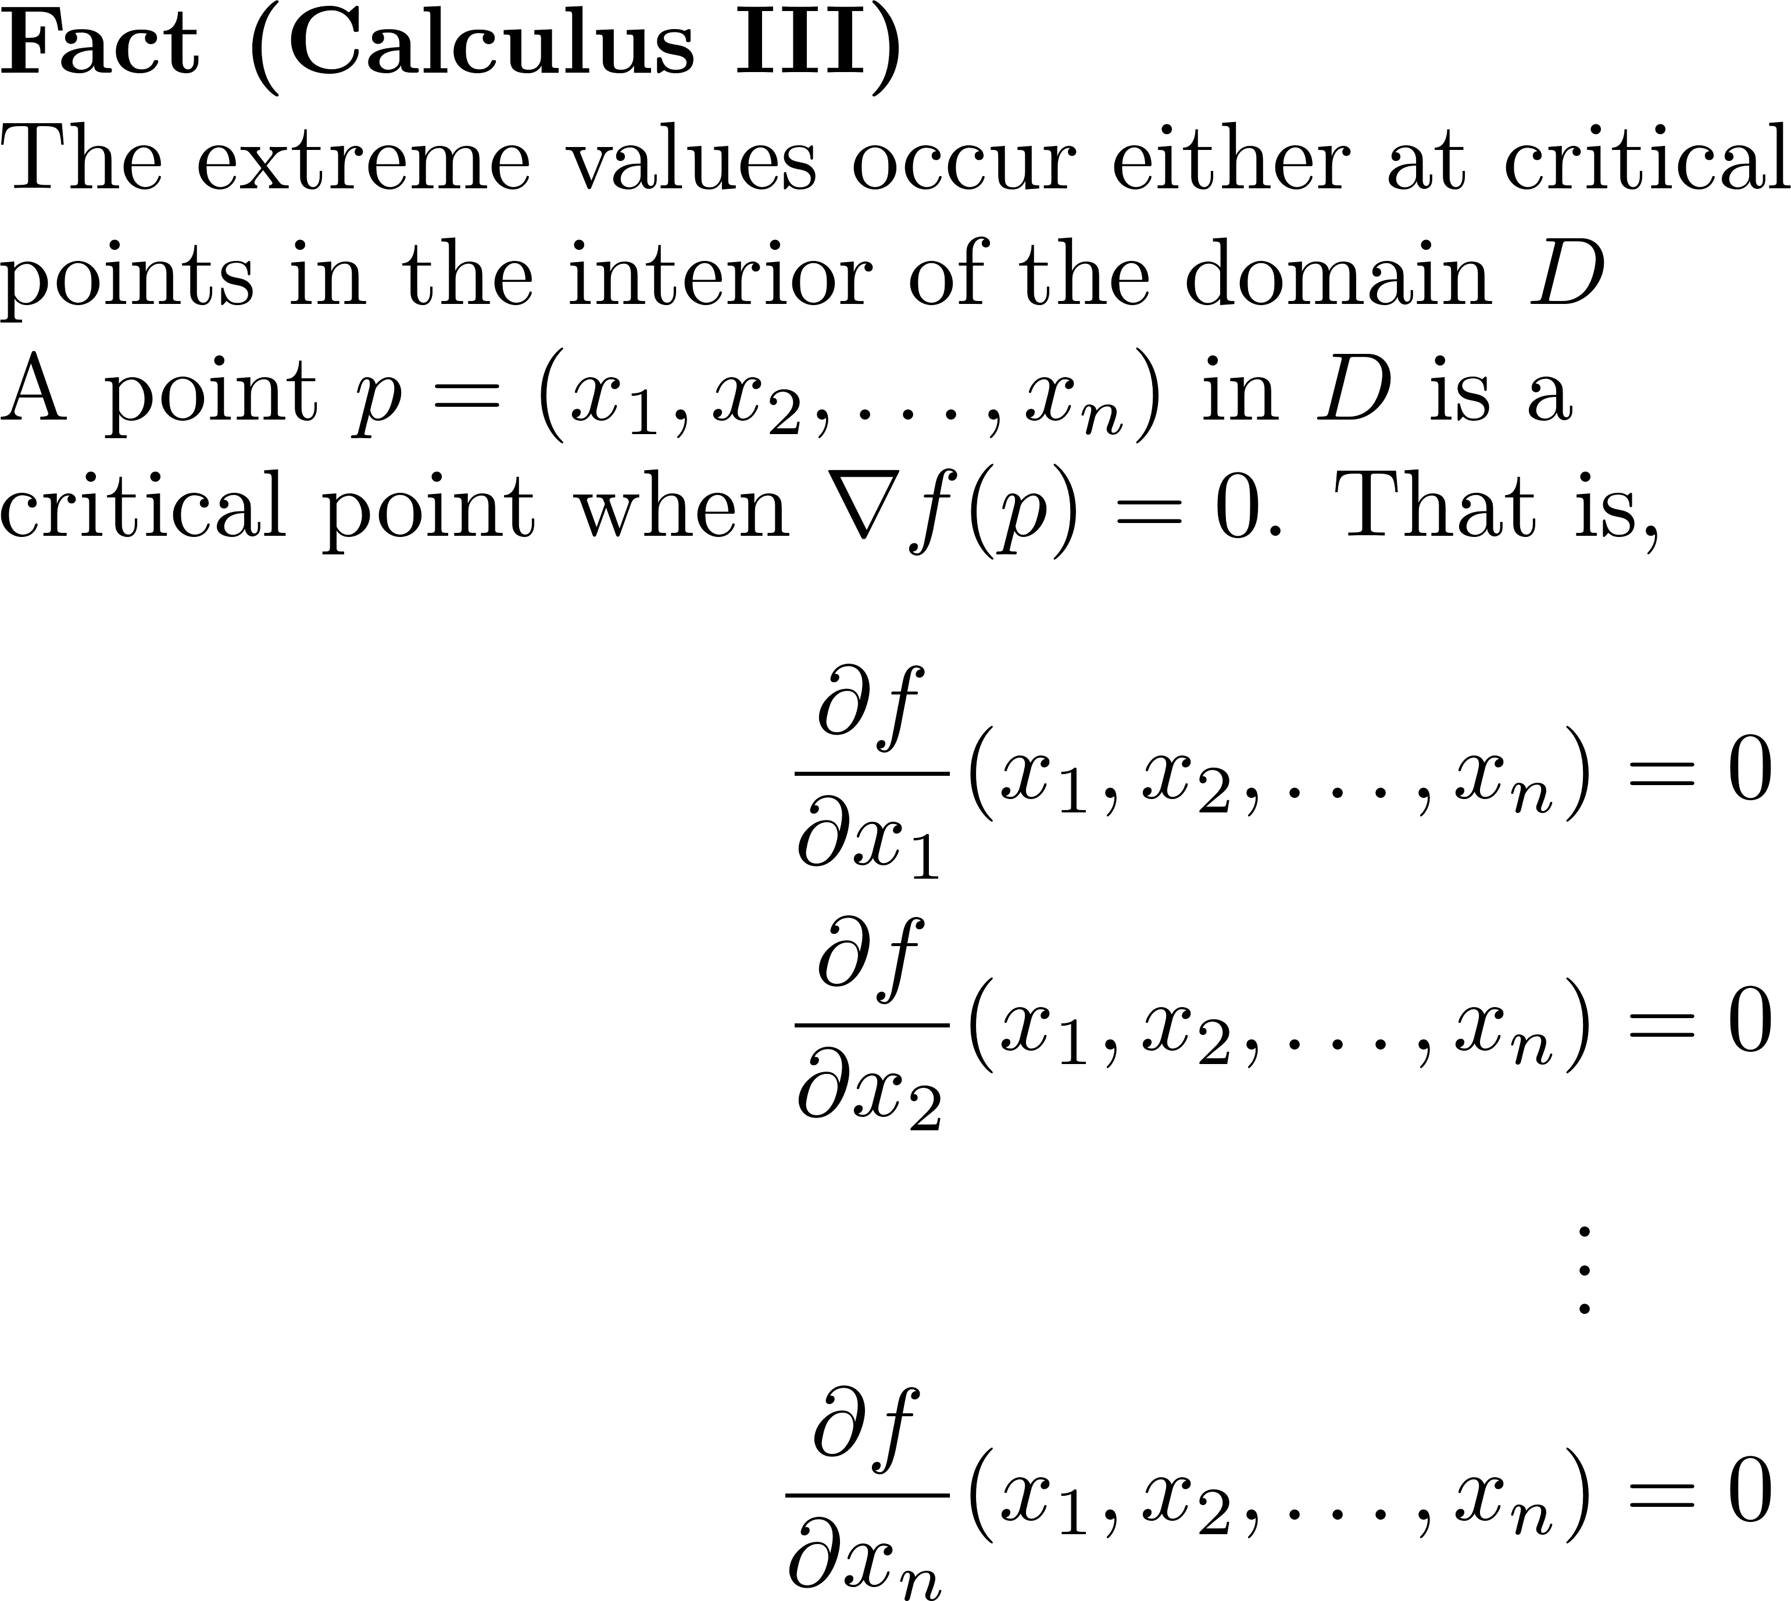
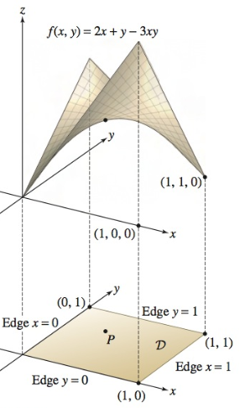
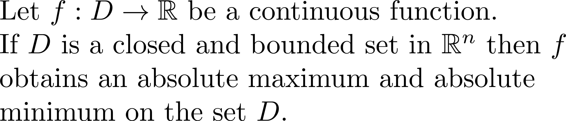
Extreme Value Theorem (Calculus III)
Extreme Value Theorem (EVT)

Slide 8
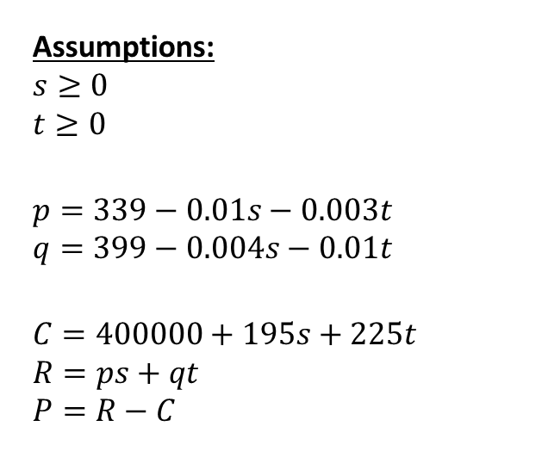
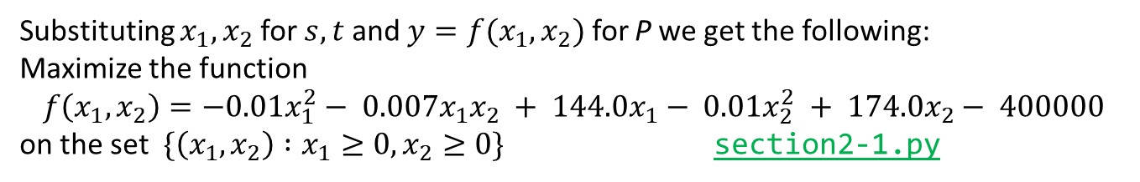
Step 3: Formulate the model
Assumptions:
$$s≥0$$
$$t≥0$$
$$p=339−0.01s−0.003t$$
$$q=399−0.004s−0.01t$$
$$C=400000+195s+225t \\ R=ps+qt \\ P=R−C$$
Working backwards through our assumptions:
Substituting $x_{1},x_{2}$ for $s,t$ and ${y=f(x}_{1},x_{2})$ for P we get the following: Maximize the function
$$f\left(x_{1},x_{2}\right)=−0.01x_{1}^{2}− 0.007x_{1}x_{2} + 144.0x_{1}− 0.01x_{2}^{2} + 174.0x_{2}− 400000$$
on the set $\{\left(x_{1},x_{2}\right) :x_{1}≥0,x_{2}≥0\}$ section2-1.py

Slide 9
Step 4 of five-step method
Step 4. Solve the model.
Apply the procedure from Step 2 to the problem formulated in step 3.
Check for errors and confirm you solution makes sense.
Here is where we want to incorporate appropriate technology to reduce the chance for error and help to verify results.

Slide 10
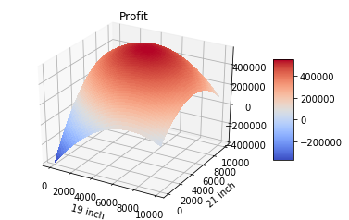
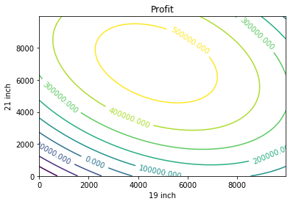
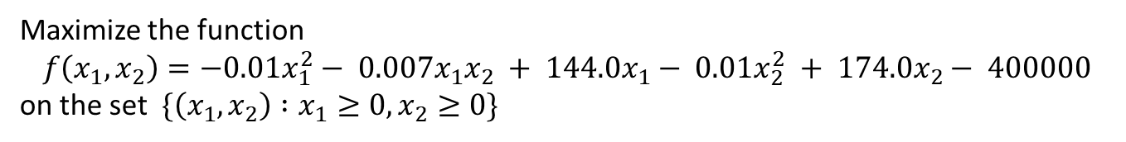
Step 4: Solve the Problem
Maximize the function
$$f\left(x_{1},x_{2}\right)=−0.01x_{1}^{2}− 0.007x_{1}x_{2} + 144.0x_{1}− 0.01x_{2}^{2} + 174.0x_{2}− 400000$$
on the set $\{\left(x_{1},x_{2}\right) :x_{1}≥0,x_{2}≥0\}$
i) Since the function is not on a closed and bounded domain we plot the function to figure out where the max might be
ii) Based on the equation and the plots the function is an elliptic paraboloid

Slide 11
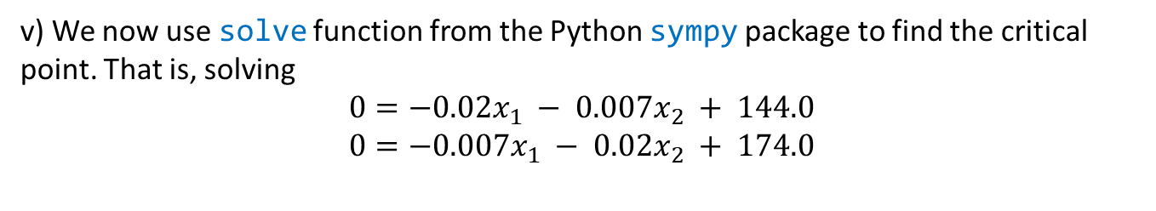
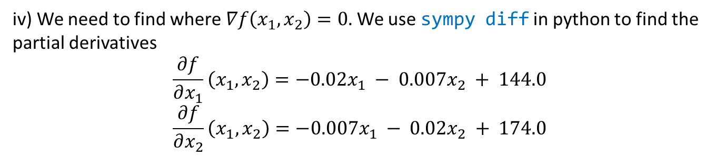
Step 4: Solve the Problem
Maximize the function
$$f\left(x_{1},x_{2}\right)=−0.01x_{1}^{2}− 0.007x_{1}x_{2} + 144.0x_{1}− 0.01x_{2}^{2} + 174.0x_{2}− 400000$$
on the set $\{\left(x_{1},x_{2}\right) :x_{1}≥0,x_{2}≥0\}$
iii) The maximum will occur at a critical point.
iv) We need to find where $∇f\left(x_{1},x_{2}\right)=0.$We use sympy diff in python to find the partial derivatives
$$\frac{∂f}{∂x_{1}}\left(x_{1},x_{2}\right)=−0.02x_{1} − 0.007x_{2} + 144.0$$
$$\frac{∂f}{∂x_{2}}\left(x_{1},x_{2}\right)=−0.007x_{1} − 0.02x_{2} + 174.0$$
v) We now use solve function from the Python sympy package to find the critical point. That is, solving
$$0=−0.02x_{1} − 0.007x_{2} + 144.0$$
$$0=−0.007x_{1} − 0.02x_{2} + 174.0$$
Notes:
Notice we have a system of linear equations, which we can solve with several methods, Gauss-Jordan, Inverse matrices, etc.

Slide 12
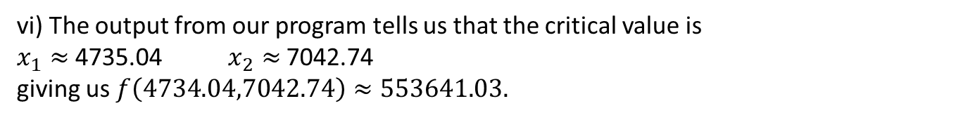
Step 4: Solve the Problem
vi) The output from our program tells us that the critical value is
$x_{1}≈$4735.04 $x_{2}≈$7042.74
giving us $f\left(4734.04,7042.74\right)≈553641.03.$
vii) This solution seems reasonable based on our previous plots.

Slide 13
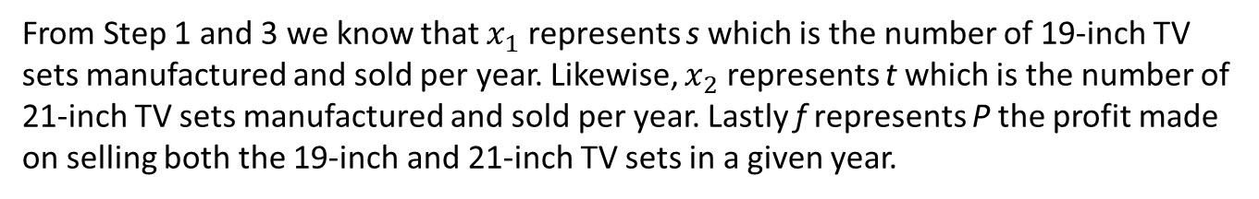
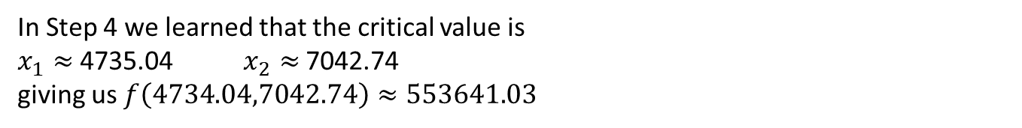
Step 5: Answer the question
Recall here we need to keep in mind.
Avoid technical jargon and mathematical symbols.
Anyone that can understand the original question should be able to understand your solution.
In Step 4 we learned that the critical value is
$x_{1}≈$4735.04 $x_{2}≈$7042.74
giving us $f\left(4734.04,7042.74\right)≈553641.03$
From Step 1 and 3 we know that $x_{1}$ represents s which is the number of 19-inch TV sets manufactured and sold per year. Likewise, $x_{2}$ represents t which is the number of 21-inch TV sets manufactured and sold per year. Lastly f represents P the profit made on selling both the 19-inch and 21-inch TV sets in a given year.

Slide 14
Step 5: Answer the question
The company can maximize profits by manufacturing 4,735 of the 19-inch sets and 7,043 of the 21-inch sets, resulting in a net profit of $553,641.
Moreover, the average selling price for the 19-inch set is $270.52 and the average selling price for the 21-inch set is $309.63.
The projected revenue is $3,461,590 which gives the company a profit margin (profit/revenue) of approximately 16%.
Based on the given information we should recommend the company proceed with the introduction of the product.

Slide 15
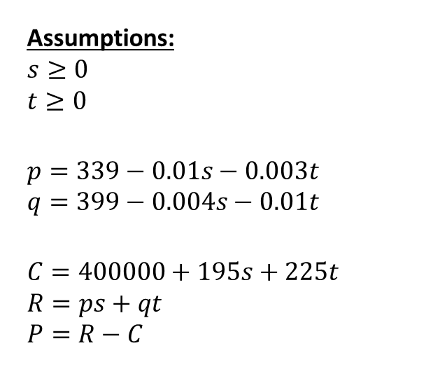
Sensitivity Analysis
Assumptions:
$$s≥0$$
$$t≥0$$
$$p=339−0.01s−0.003t$$
$$q=399−0.004s−0.01t$$
$$C=400000+195s+225t \\ R=ps+qt \\ P=R−C$$
Parameters:
$0.01 – amount of price drop per unit sold
$0.003 – amount of price drop for 19-inch set for each 21-inch sold
$0.004 – amount of price drop for 21-inch set for each 19-inch sold
All of these parameters will affect our optimal solution, in particular our values for s and t.
We need to ensure that our conclusions are robust with respect to the assumptions about both the market for TV sets and the manufacturing process.

Slide 16
Sensitivity Analysis – Price Elasticity
Parameters:
$0.01 – amount of price drop for 19-inch set for each 19-inch set sold
$0.01 – amount of price drop for 21-inch set for each 21-inch set sold
$0.003 – amount of price drop for 19-inch set for each 21-inch set sold
$0.004 – amount of price drop for 21-inch set for each 19-inch set sold
All three parameters are of a particular type. They define how the selling price changes based on the units sold.
Price Elasticity is the term used by economists to describe the sensitivity of quantity sold to the asking price.
Sensitivity analysis for all the elasticities should be carried out.
Notes:
Note: the first one is really two parameters.

Slide 17
Price Elasticity of 19-inch set
Parameters:
a – amount of price drop for 19-inch set for each 19-inch set sold
$0.01 – amount of price drop for 21-inch set for each 21-inch set sold
$0.003 – amount of price drop for 19-inch set for each 21-inch set sold
$0.004 – amount of price drop for 21-inch set for each 19-inch set sold
We will per form sensitivity analysis on the amount of price drop for a 19-inch set for each 19-inch set sold, calling this parameter a.
We now examine how this changes the model.
Notes:
Note: the first one is really two parameters.

Slide 18
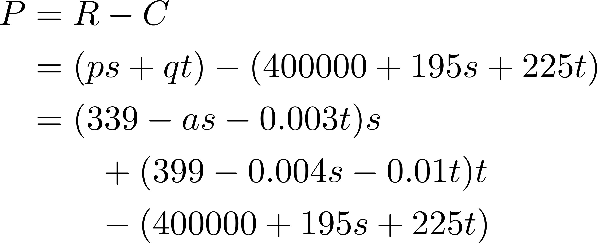
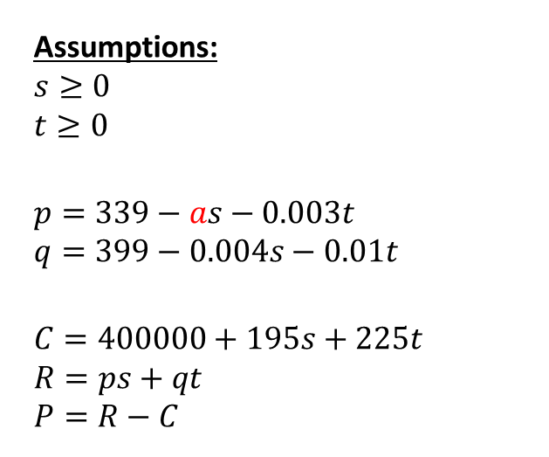
Price Elasticity of 19-inch set
Parameters:
a – amount of price drop for 19-inch set for each 19-inch set sold
$0.01 – amount of price drop for 21-inch set for each 21-inch set sold
$0.003 – amount of price drop for 19-inch set for each 21-inch set sold
$0.004 – amount of price drop for 21-inch set for each 19-inch set sold
Assumptions:
$$s≥0$$
$$t≥0$$
$$p=339−as−0.003t$$
$$q=399−0.004s−0.01t$$
$$C=400000+195s+225t \\ R=ps+qt \\ P=R−C$$
Notes:
Note: the first one is really two parameters.

Slide 19
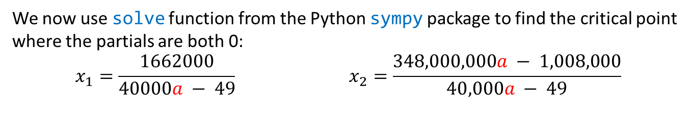

Reexamining Calculations
After using sympy simplification (simplify) the function is now
$$f\left(x_{1},x_{2}\right)=−ax_{1}^{2}− 0.007x_{1}x_{2} + 144.0x_{1}− 0.01x_{2}^{2} + 174.0x_{2}− 400000$$
Using sympy diff in python we find the partial derivatives
$$\frac{∂f}{∂x_{1}}\left(x_{1},x_{2}\right)=−2ax_{1} − 0.007x_{2} + 144.0$$
$$\frac{∂f}{∂x_{2}}\left(x_{1},x_{2}\right)=−0.007x_{1} − 0.02x_{2} + 174.0$$
We now use solve function from the Python sympy package to find the critical point where the partials are both 0:
$$x_{1}=\frac{1662000}{40000a − 49} x_{2}=\frac{348,000,000a − 1,008,000}{40,000a − 49}$$
Notes:
Notice we have a system of linear equations, which we can solve with several methods, Gauss-Jordan, Inverse matrices, etc.
See python file section1-1pig.py

Slide 20
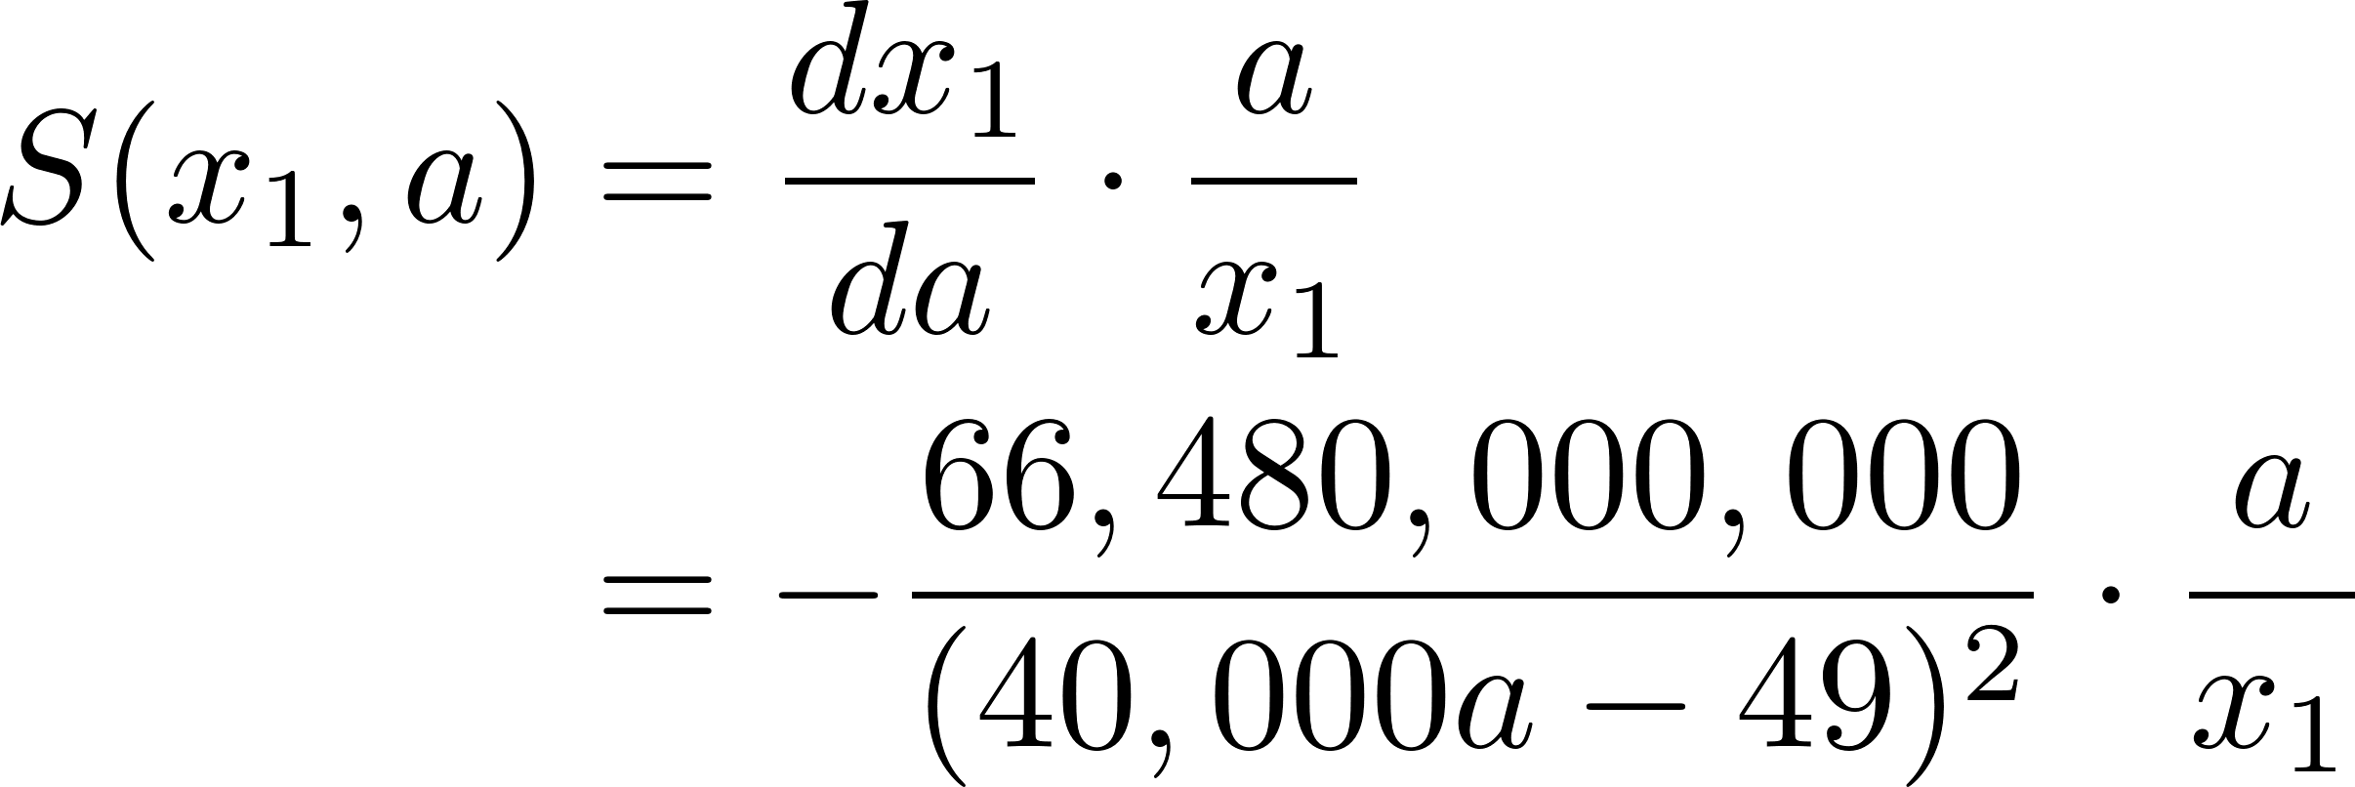


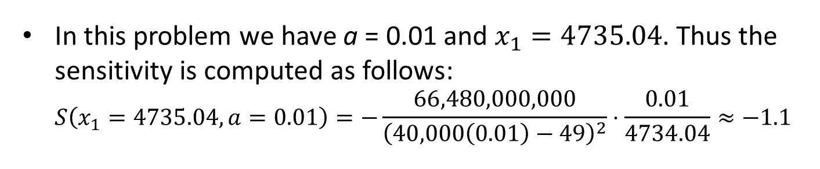

Sensitivity of $x_{1}$ to a
We left off with $x_{1}=\frac{1662000}{40000a − 49}$
Recall our definition of $S\left(x_{1},a\right)=\frac{dx_{1}}{da}⋅\frac{a}{x_{1}}$ Thus,
In this problem we have a = 0.01 and $x_{1}=4735.04$. Thus the sensitivity is computed as follows: $S\left(x_{1}=4735.04,a=0.01\right)=−\frac{66,480,000,000}{{\left(40,000\left(0.01\right)−49\right)}^{2}}⋅\frac{0.01}{4734.04}≈−1.1$

Slide 21
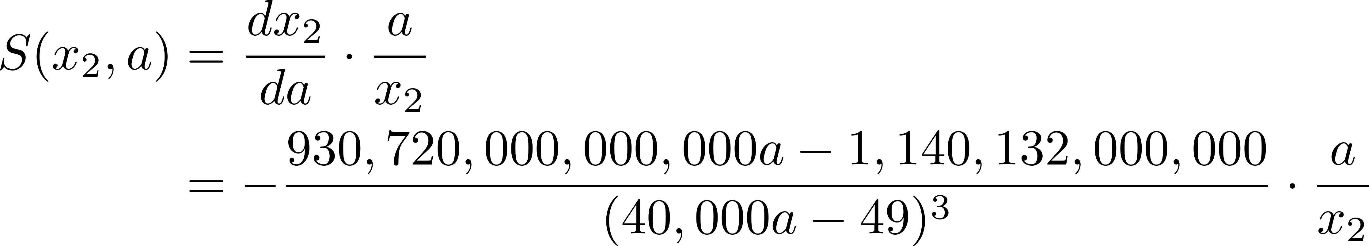


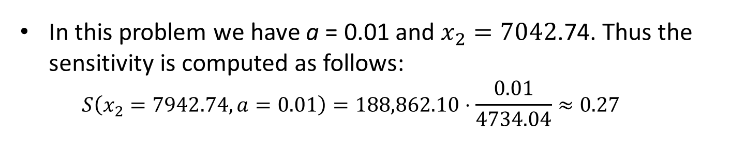

Sensitivity of $x_{2}$ to a
We have $x_{2}=\frac{348,000,000a − 1,008,000}{40,000a − 49}$
Recall our definition of $S\left(x_{2},a\right)=\frac{dx_{2}}{da}⋅\frac{a}{x_{2}}$Thus,
In this problem we have a = 0.01 and $x_{2}=7042$.74. Thus the sensitivity is computed as follows: $S\left(x_{2}=7942.74,a=0.01\right)=188,862.10⋅\frac{0.01}{4734.04}≈0.27$

Slide 22

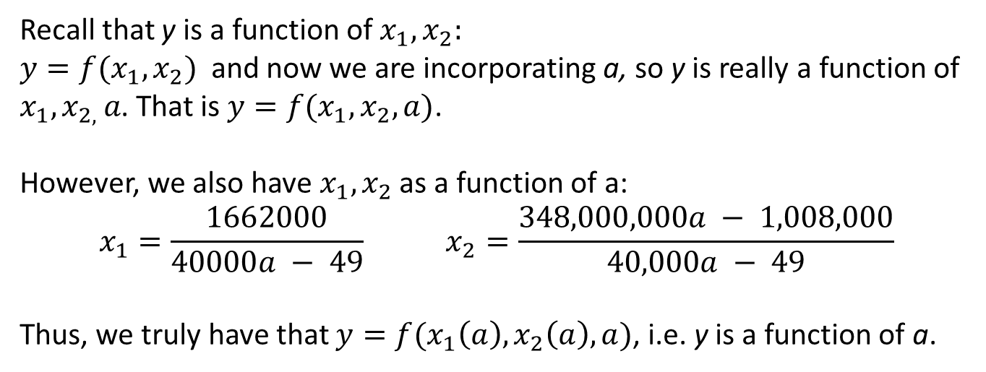
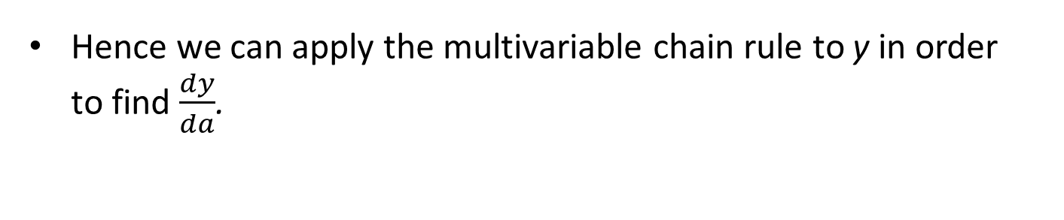
Sensitivity of $y$ to a
Recall that y is a function of ${x_{1}, x}_{2}:$
${{y=f(x}_{1}, x}_{2})$ and now we are incorporating a, so y is really a function of ${x_{1}, x}_{2, }a$. That is ${{y=f(x}_{1}, x}_{2}, a)$. However, we also have ${x_{1}, x}_{2}$ as a function of a: $$x_{1}=\frac{1662000}{40000a − 49} x_{2}=\frac{348,000,000a − 1,008,000}{40,000a − 49}$$
Thus, we truly have that ${{y=f(x}_{1}\left(a\right), x}_{2}\left(a\right), a)$, i.e. y is a function of a.
Hence we can apply the multivariable chain rule to y in order to find $\frac{dy}{da}$.

Slide 23
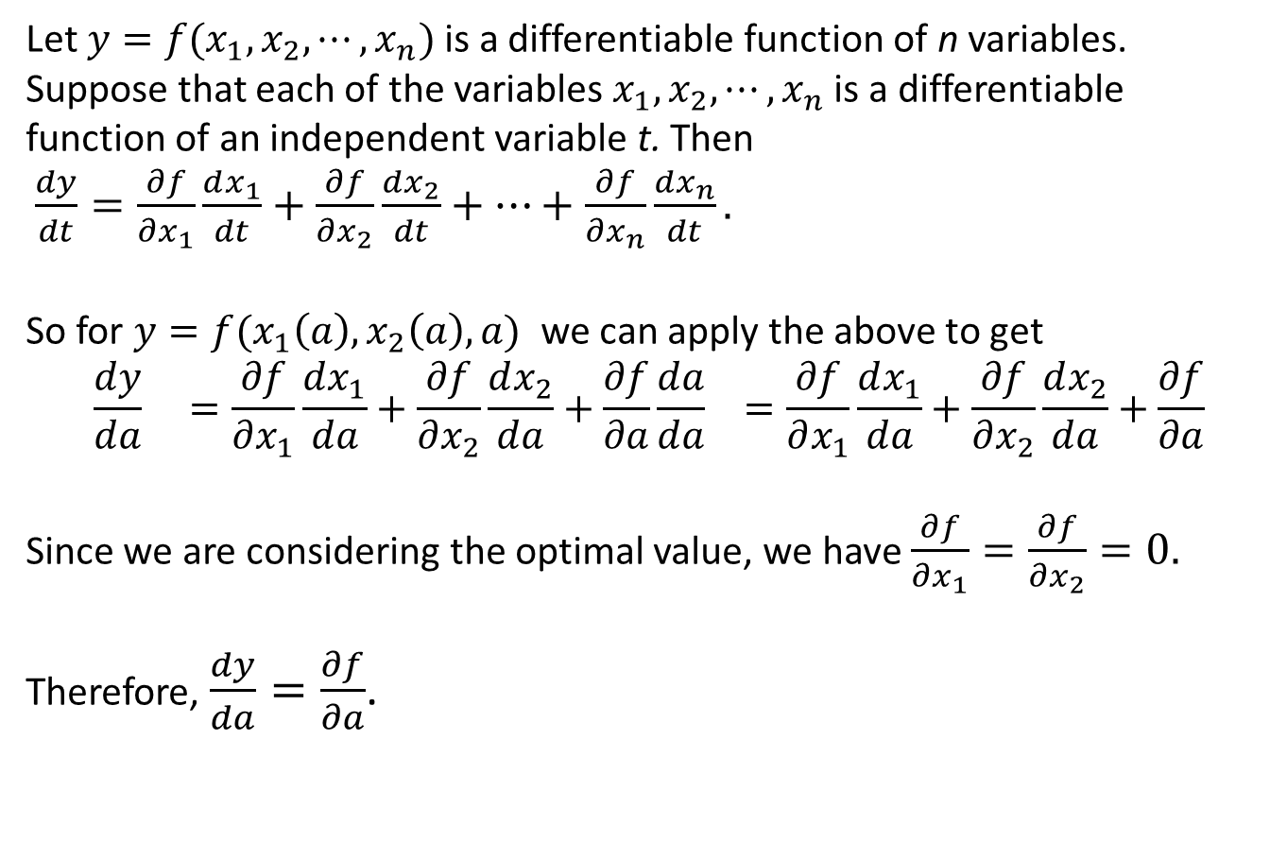
Multivariable Chain Rule
Let ${{y=f(x}_{1}, x}_{2}, ⋯, x_{n})$ is a differentiable function of n variables. Suppose that each of the variables ${x_{1}, x}_{2}, ⋯, x_{n}$ is a differentiable function of an independent variable t. Then
${{\frac{dy}{dt}=\frac{∂f}{∂x_{1}}\frac{dx_{1}}{dt}+\frac{∂f}{∂x_{2}}\frac{dx_{2}}{dt}+⋯+\frac{∂f}{∂x_{n}}\frac{dx_{n}}{dt}.}_{}}_{}$
So for ${{y=f(x}_{1}\left(a\right), x}_{2}\left(a\right),a)$ we can apply the above to get
$$\frac{dy}{da} =\frac{∂f}{∂x_{1}}\frac{dx_{1}}{da}+\frac{∂f}{∂x_{2}}\frac{dx_{2}}{da}+\frac{∂f}{∂a}\frac{da}{da} =\frac{∂f}{∂x_{1}}\frac{dx_{1}}{da}+\frac{∂f}{∂x_{2}}\frac{dx_{2}}{da}+\frac{∂f}{∂a}$$
Since we are considering the optimal value, we have $\frac{∂f}{∂x_{1}}=\frac{∂f}{∂x_{2}}=0.$
Therefore, $\frac{dy}{da}=\frac{∂f}{∂a}$.
Notes:
Geometric Intepretation: since we near optimimun small changes in x_1 and x_2 will have little impact on the overall profit. Almost all the of the change in profits will be due a change in a, which causing a change in the selling price.

Slide 24

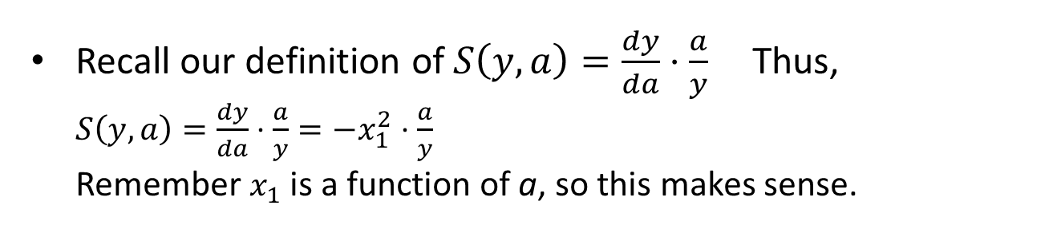
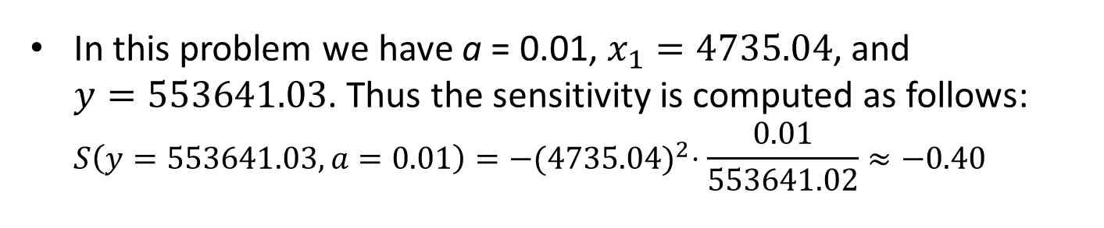
Sensitivity of $y$ to a
We have $\frac{dy}{da}=\frac{∂y}{∂a}=−x_{1}^{2}$
Recall our definition of $S\left(y,a\right)=\frac{dy}{da}⋅\frac{a}{y}$Thus, $S\left(y,a\right)=\frac{dy}{da}⋅\frac{a}{y}=−x_{1}^{2}⋅\frac{a}{y}$ Remember $x_{1}$ is a function of a, so this makes sense.
In this problem we have a = 0.01, $x_{1}=4735.04$, and $y=553641.03$. Thus the sensitivity is computed as follows: $S\left(y=553641.03,a=0.01\right)=−{(4735.04)}^{2}⋅\frac{0.01}{553641.02}≈−0.40$

Slide 25
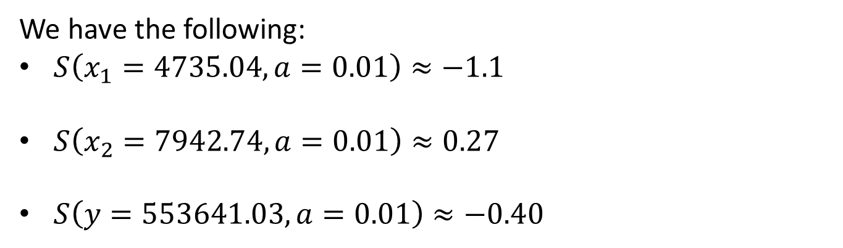
Sensitivity Interpretation
We have the following:
$S\left(x_{1}=4735.04,a=0.01\right)≈−1.1$
$S\left(x_{2}=7942.74,a=0.01\right)≈0.27$
$S\left(y=553641.03,a=0.01\right)≈−0.40$
Interpretation:
If the price elasticity for the 19-inch sets were to increase by 10% then we should make 11% fewer 19-inch sets and 2.7% more 21-inch sets. The resulting profit would decrease by 4%.

Slide 26
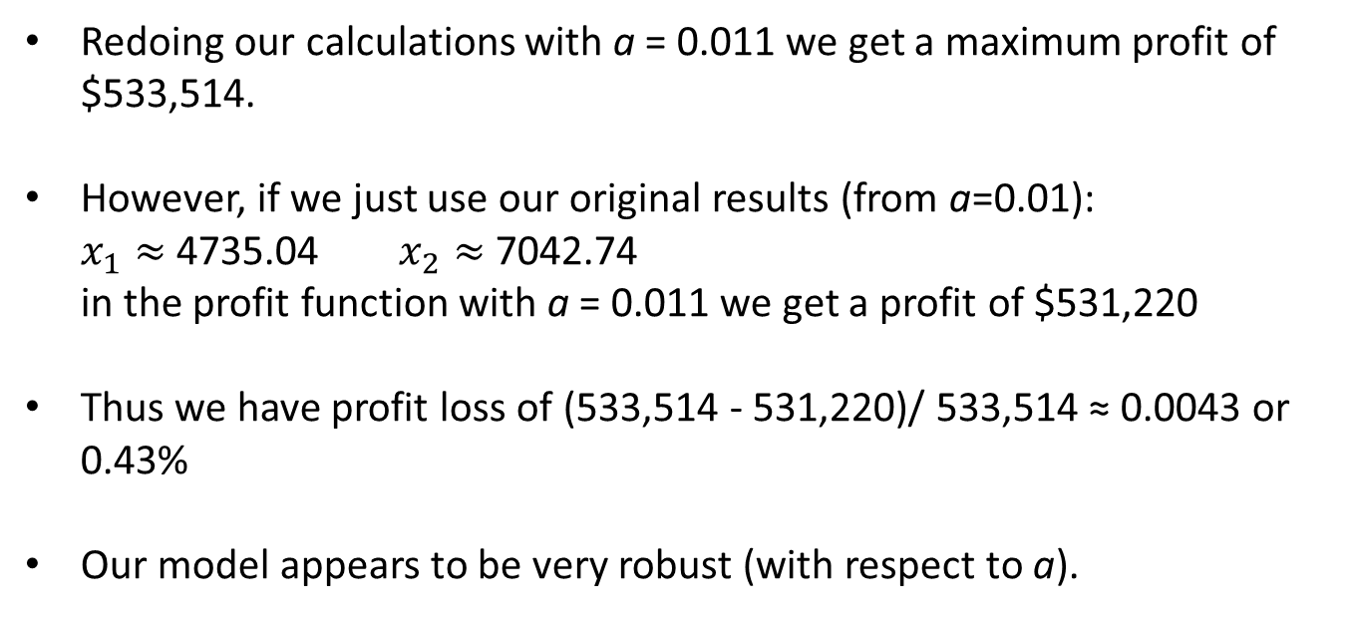
Robustness with respect to a
Suppose we are 10% off on our estimation of a = 0.01. So, really a = 0.011.
Redoing our calculations with a = 0.011 we get a maximum profit of $533,514.
However, if we just use our original results (from a=0.01): $x_{1}≈$4735.04 $x_{2}≈$7042.74 in the profit function with a = 0.011 we get a profit of $531,220
Thus we have profit loss of (533,514 - 531,220)/ 533,514 ≈ 0.0043 or 0.43%
Our model appears to be very robust (with respect to a).

Slide 27
Notes on Robustness
Our model is based on a linear price structure. Is this reasonable?
Practically, we usually do the following
You begin with an educated guess about the market size for the project and a reasonable average sales price. - these sometimes come from past statistical data and/or market studies
We can also get reasonable estimates for elasticities over a range of values that includes the optimal values - in effect, we are making a linear approximation of a nonlinear function over a “small” region (this is Calculus in a nutshell)

